Slide 1
TODAYS CHAPTER:
LASER

Slide 2
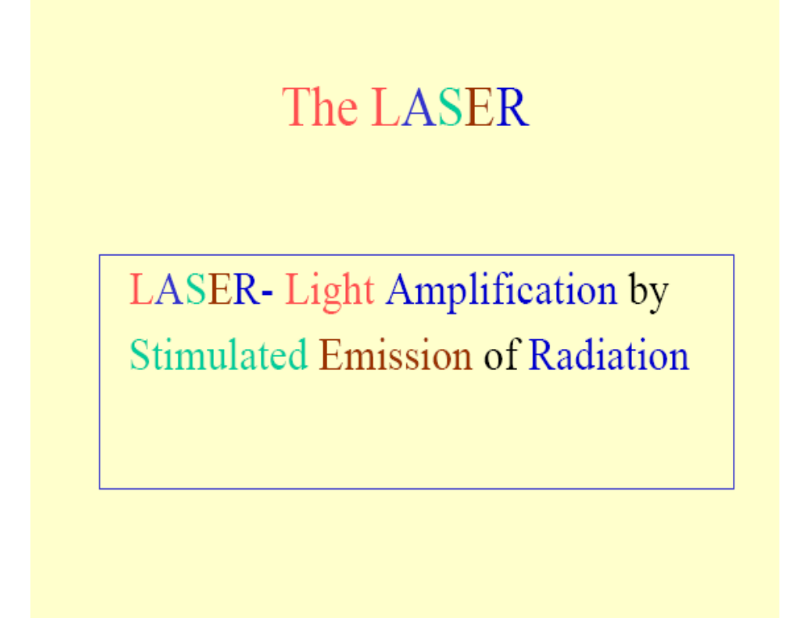
Notes:
yhhh

Slide 3
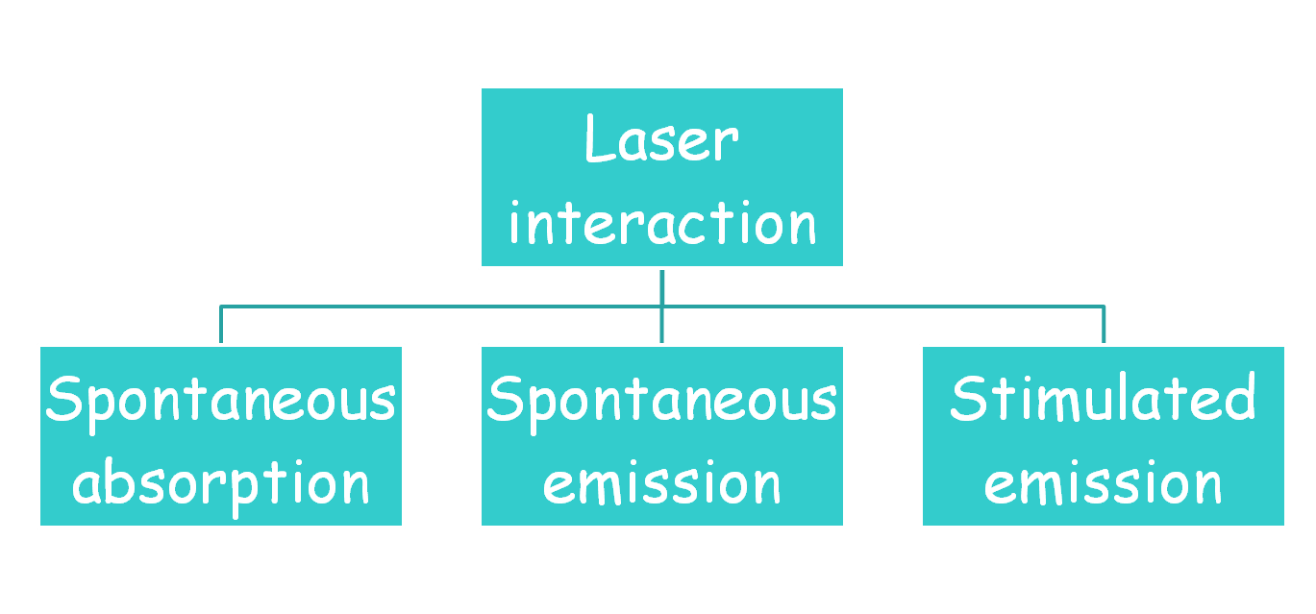
LASER ACTION

Slide 4
ABSORPTION:-Atoms and molecules can also absorb photons, making a transition from a lower level to a more excited one.
Excited level
This is, of course, absorption.
Energy
Ground level
Notes:
Image from http://phyun5.ucr.edu/~wudka/Physics7/Notes_www/node107.html

Slide 5
SPONTANEOUS EMISSION
When an atom in an excited state falls to a lower energy level, it emits a photon of light.
Excited level
Energy
Ground level

Slide 6
Spontaneous emission
Consider an atom in higher state (E2).
It can decay to lower energy level by emitting photon.
Emitted photon have energy hv=E2-E1.
Life time of excited state is 10⁻⁹sec.
E2
Photon
hv=E2-E1
E1

Slide 7


Stimulated emission
There are metastable state i.e. transition from this state is not allowed acc to selection rule.
There life time is 10⁻³ sec.
Atom in this state can’t jump to lower state at there own.
When an photon of suitable freq arrive it make the atom in metastable unstable.
The emitted photon is in coherence with incident photon.
Metastable state(10⁻³sec)
Incident photon
Emitted
Photon coherent

Slide 8
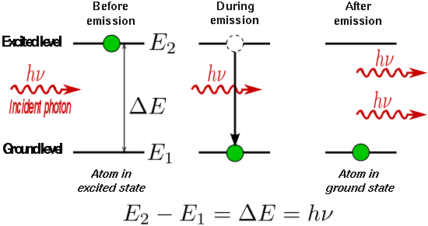
Stimulated Emission

Slide 9
Stimulated vs Spontaneous Emission
Stimulated emission requires the presence of a photon.An “incoming” photon stimulates a molecule in an excited state to decay to the ground state by emitting a photon. The stimulated photons travel in the same direction as the incoming photon.
Spontaneous emission does not require the presence of a photon. Instead a molecule in the excited state can relax to the ground state by spontaneously emitting a photon. Spontaneously emitted photons are emitted in all directions.

Slide 10
Before After
Spontaneous emission
Absorption
Stimulated
emission

Slide 11
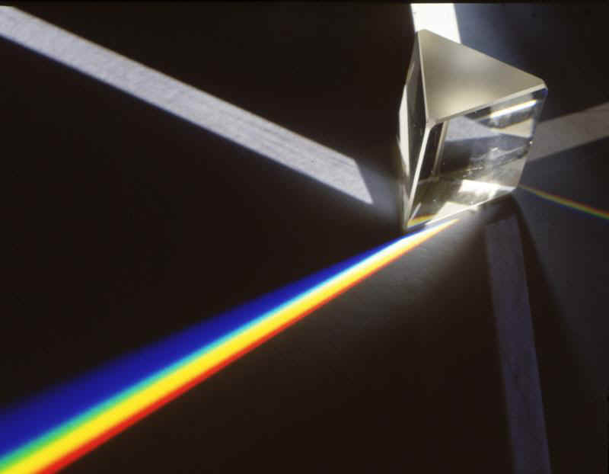
Properties of Laser
Monochromatic
The light emitted from a laser is monochromatic, that is, it is of one wavelength (color). In contrast, ordinary white light is a combination of many different wavelengths (colors).

Slide 12
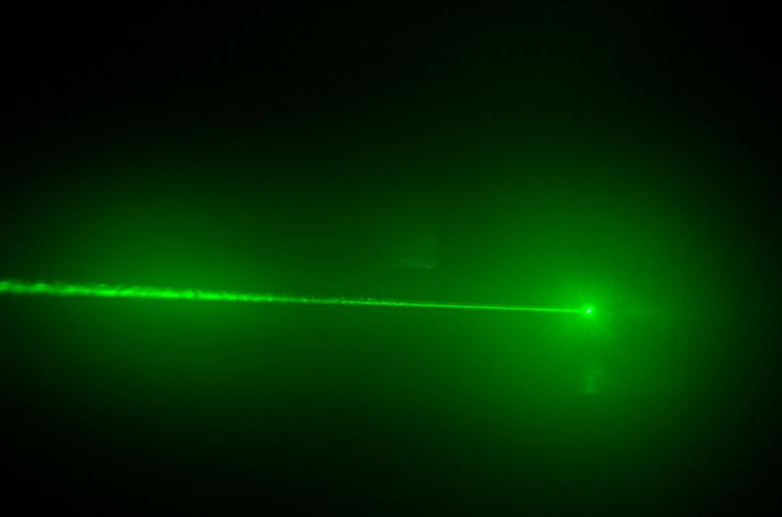

Properties of Laser
Directional:
Lasers emit light that is highly directional. Laser light is emitted as a relatively narrow beam in a specific direction. Ordinary light, such as coming from the sun, a light bulb, or a candle, is emitted in many directions away from the source.

Slide 13
Properties of Laser
Coherent
The light from a laser is said to be coherent, which means the wavelengths of the laser light are in phase in space and time.

Slide 14
Two-Level System
E_{m}, N_{m}
E_{m}, N_{m}
E_{n}, N_{n}
E_{n}, N_{n}
Even with very a intense pump source, the best one can achieve with a two-level system is
excited state population = ground state population

Slide 15
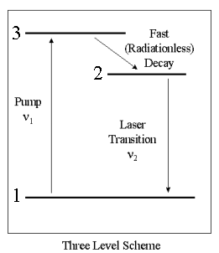
Three-level Laser System

Slide 16
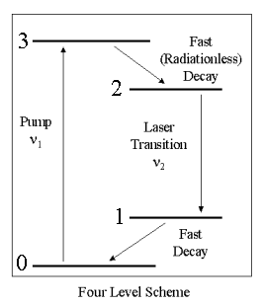
FOUR LEVEL LASER:

Slide 17
Types of LASER
Semiconductor Diode Laser
2. CO2 Laser

Slide 18
Semiconductor Diode Laser
PN Junction is forward biased.
PN Junction is heavily doped
Types:
Homojunction Laser
Heterojunction Laser

Slide 19
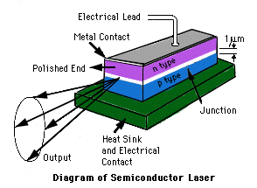
Semiconductor laser

Slide 20
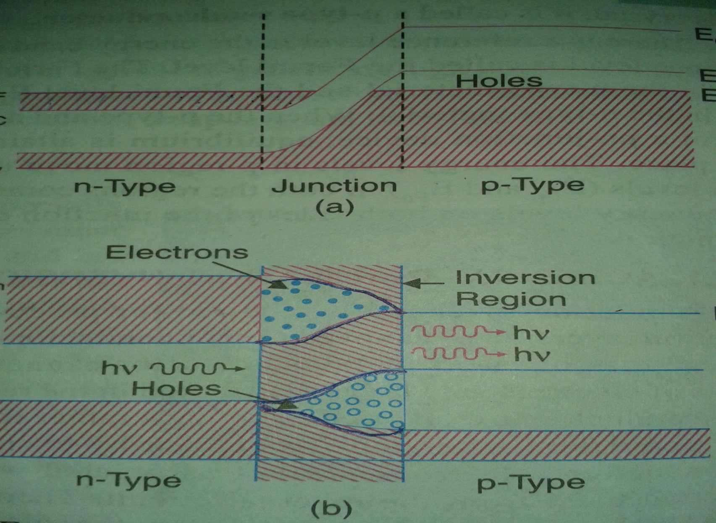

Slide 21
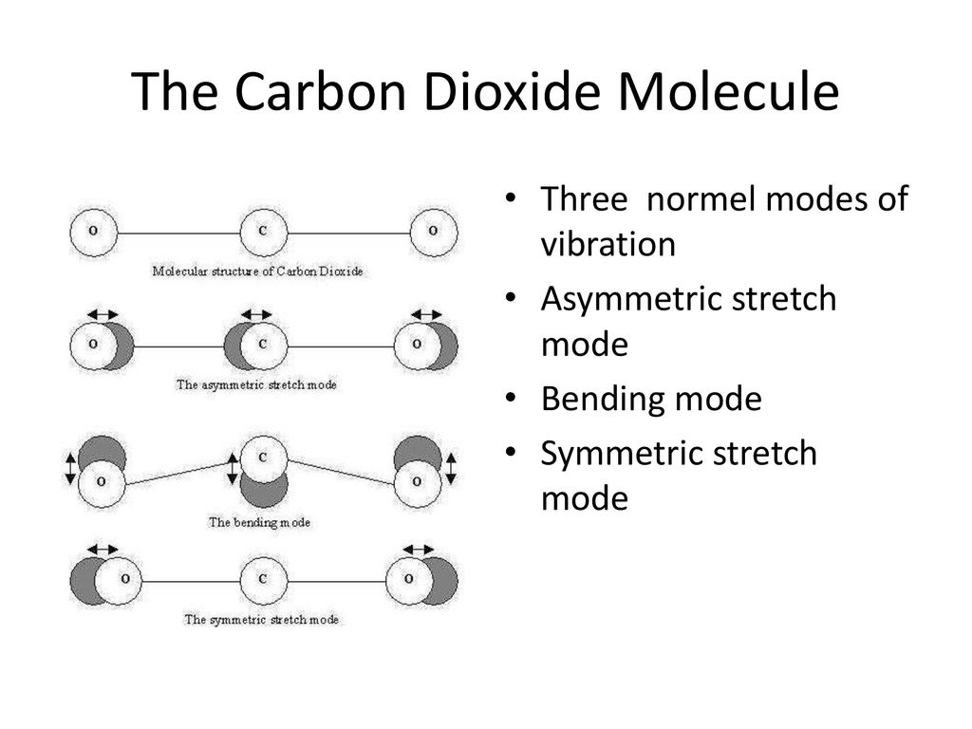
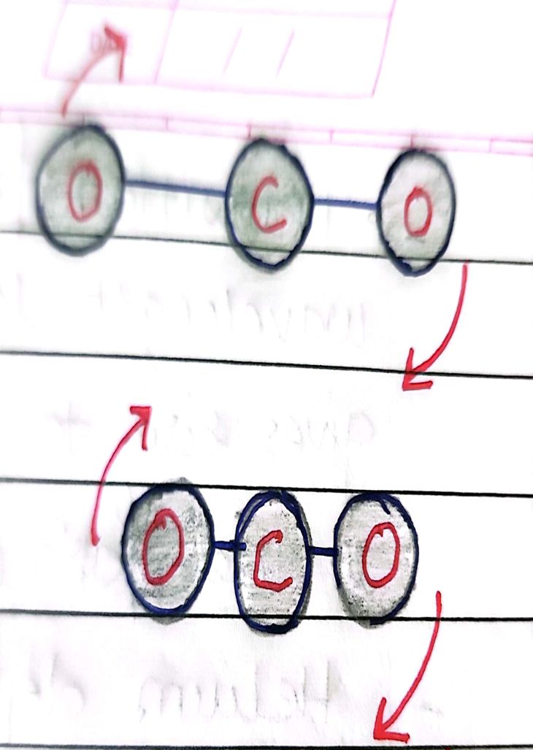
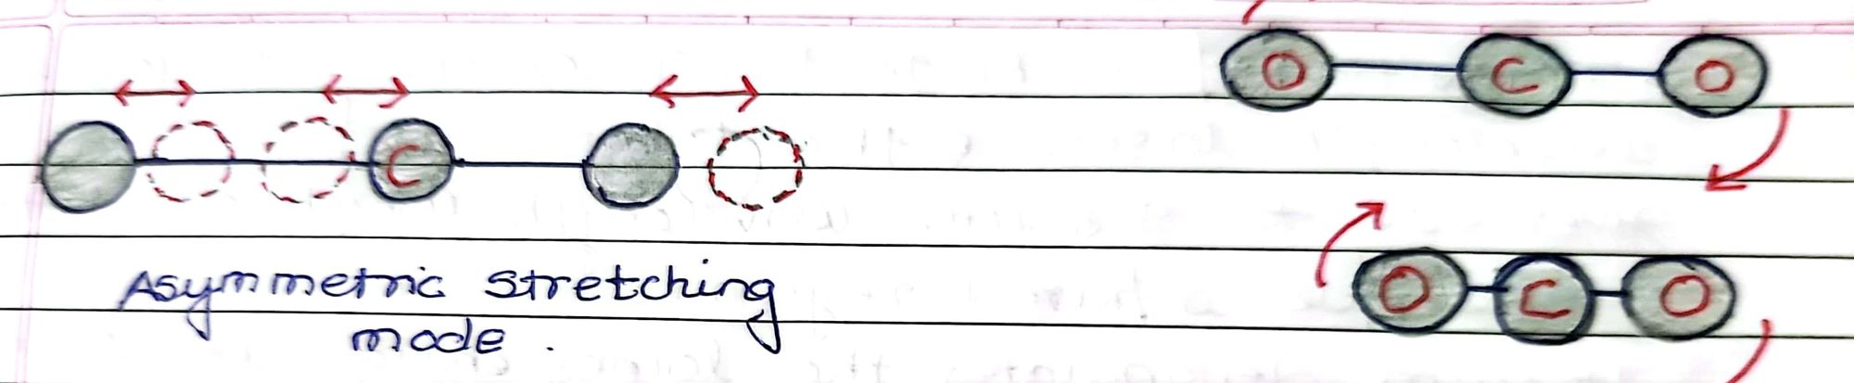
CO2 Laser
Rotational modes
Vibrational modes

Slide 22
CO2 molecule is linear molecule.
3 Independent vibrational mode:
Stretch mode ,bending mode, asymmetric mode
1 Rotational Mode
Difference in energies between these molecular levels
is small as compared to atomic energy level.
Hence radiation emitted by transition in molecular
energy levels lies in infrared region of these spectrum.

Slide 23
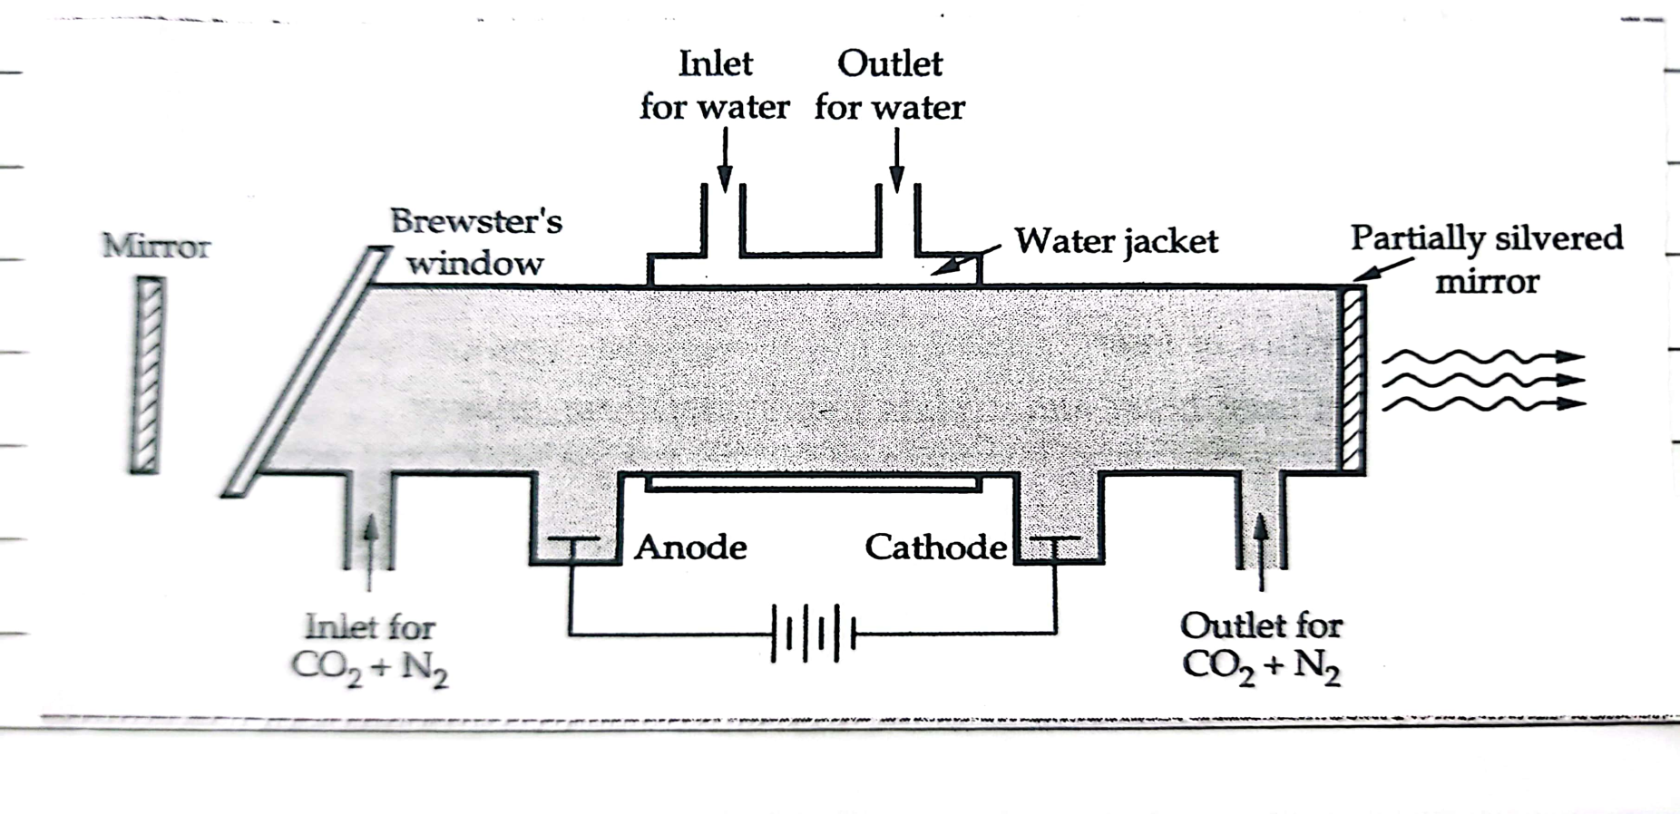
Construction:
Two electrodes connected to power supply
Mixture of 3 gases: Co2, He and N2
One end partially silvered mirror,other end completely silvered called as Brewster’s window.

Slide 24
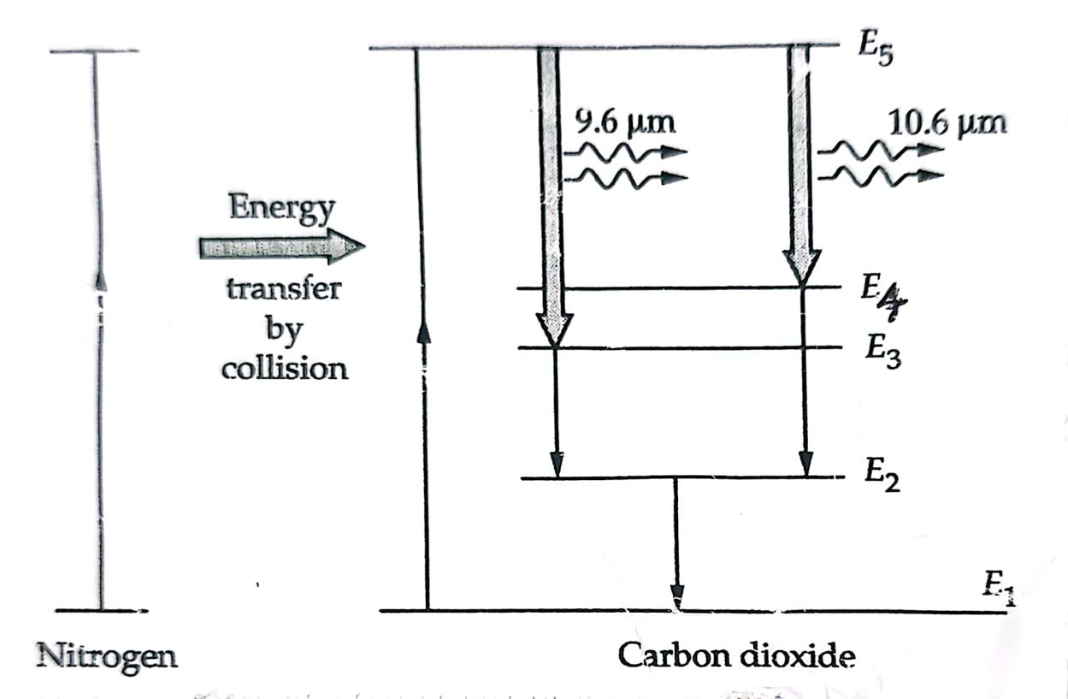
Working
High voltage across the electrode excites gas molecules
Nitrogen excited to higher level and transfer energy to CO2 molecules by collision
CO2 molecules excites to E5 state( metastable state )
Helium depopulates lower energy levels in CO2 which facilitate population inversion

Slide 25
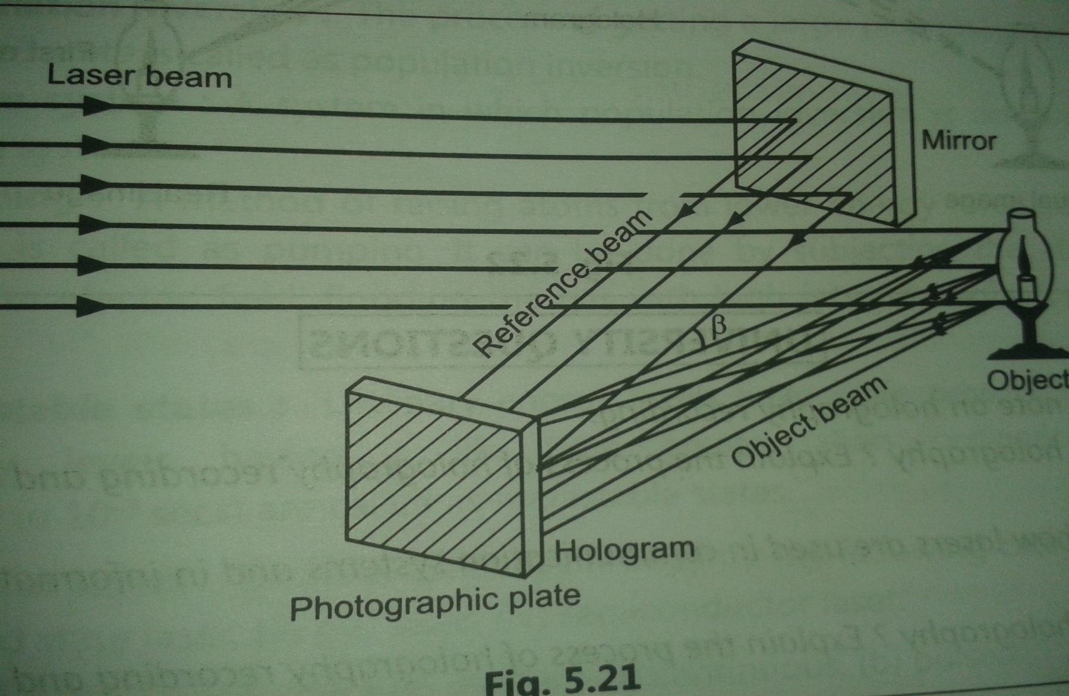
HOLOGRAPHY
Recording

Slide 26
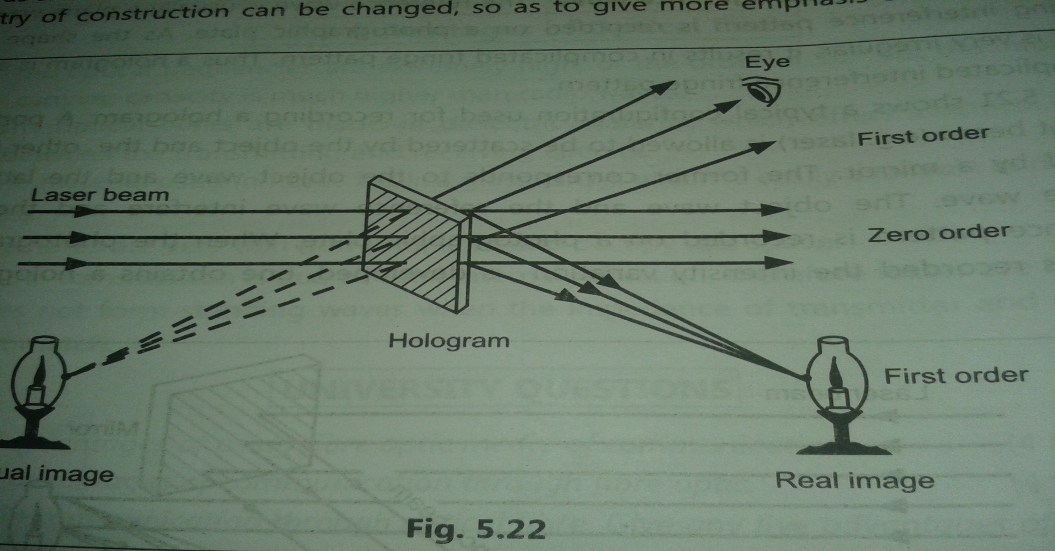
2. Reconstruction

